Slide 1
HONDA’s 3DEXPERIENCE CATIA
APS Use Cases

Slide 2









HONDA Work
Supplier X Work
Honda 3DEXPERIENCE Supplier Collaboration Overview
HONDA Work Env.
Supplier is working for HONDA in HONDA’s virtual env.
Supplier Work Env.
Supplier is working for themselves in Supplier’s env.
HONDA allow direct access from Supplier to HONDA’s 3DEXPERIENCE platform remotely to collaborate for efficient product development with new development flow.
Supplier can use DS License for Supplier’s own work
with “PCS” purchased by Supplier.
Supplier
Premise
Client Machine (VDI) on MS Azure
Honda Motor
Premise (Japan)
Platform
User
(Supplier’s Employee)
Platform
Data Base
Data Base
DS Managed DSLS
MES
Supplier’s
License Server
PCS
TAD
Honda
license
Server
PCS

Slide 3
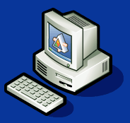

Guest Engineer usage
Case2
Client Machine (VDI)on MS Azure
Japan GE global usage
Azure Japan
Case1
Not applicable for Guest Engineer license
Client Machine (VDI)on MS Azure
Case3
Japan GE
Local usage
Case4
Country A
Azure env.
Global license
 | Case1 | Case2 | Case3 | Case4 | N/A | N/A
Azure env. | Japan | Japan | Japan | Country A | Japan | Out side JP
Guest Engineer | HM JP | HM JP | Out side JP | Honda Country A | Outsource from Honda Country A | Outsource from JP supplier
User location | Japan | Out side JP | Out side JP | Country A | Japan | 海外
License Usage | local | Global | Global | local | N/A | N/A
Licensee | HM JP | HM JP | HM JP | Honda Country A | N/A | N/A
Country A’s GE local usage
Country A’s GE global usage

Slide 4
Honda entities under Honda UPC in APS
Indonesia
HONDA R&D SOUTHEAST ASIA CO LTD [200000000016510]
PT ASTRA HONDA MOTOR [200000000010894]
PT HONDA ACCESS INDONESIA [200000000079558]
PT HONDA PRECISION PARTS MANUFACTURING [200000000015201]
PT HONDA PROSPECT MOTOR [200000000013103]
PT HONDA R&D INDONESIA [200000000079613]
PT MINEBEA ACCESSSOLUTIONS INDONESIA [200000000019069]
PT YUTAKA MANUFACTURING INDONESIA [200000000015204]
Malaysia
BOON SIEW HONDA SDN BHD [200000000070038]
HONDA ASSEMBLY (M) SDN BHD [200000000231699]
HONDA MALAYSIA SDN BHD [200000000009269]
Philippines
GOSHI PHILIPPINES INC [200000000305721]
HONDA PARTS MANUFACTURING CORP [200000000119150]
HONDA PHILIPPINES INC [200000000030664]
Thailand
ASIAN HONDA MOTOR CO LTD [200000000011428]
ASIAN PARTS MANUFACTURING CO LTD [200000000145990]
ATSUMITEC THAILAND CO LTD [200000000114813]
HONDA ACCESS ASIA AND OCEANIA CO LTD [200000000016268]
HONDA AUTOMOBILE (THAILAND) CO LTD [200000000013701]
HONDA ENGINEERING ASIAN CO LTD [200000000017970]
HONDA FOUNDRY (ASIAN) CO LTD [200000000035994]
HONDA R&D ASIA PACIFIC CO LTD [200000000018840]
HONDA R&D SOUTHEAST ASIA CO LTD [200000000010695]
HONDA TRADING ASIA COMPANY LIMITED [200000000450369]
MINEBEA ACCESSSOLUTIONS R&D ASIA LTD [200000000023417]
MINEBEA ACCESSSOLUTIONS THAI LTD [200000000013761]
SIAM GOSHI MANUFACTURING CO LTD [200000000014711]
SIAM YACHIYO CO LTD [200000000034473]
THAI HONDA CO LTD [200000000927079]
THAI HONDA MANUFACTURING CO LTD [200000000013703]
YS TECH (THAILAND) CO LTD [200000000033599]
Vietnam
GOSHI-THANG LONG AUTO-PARTS CO LTD [200000000657392]
HONDA R&D SOUTHEAST ASIA CO LTD [200000000040913]
HONDA VIETNAM CO LTD [200000000011184]

Slide 5
Guest Engineer usage – Honda asean
Case2
Client Machine (VDI)on MS Azure
Japan GE global usage
Azure Japan
Case1
Case 5 to 9
Client Machine (VDI)on MS Azure
Japan GE
Local usage
Singapore
Azure env.
 | Case5 | Case6 | Case7 | Case8 | Case9 | Case10
Azure env. | Singapore | Singapore | Singapore | Singapore | Singapore | Japan
Guest Engineer | Indonesia | Malaysia | Philippines | Thailand | Vietnam | Thailand
User location | Indonesia | Malaysia | Philippines | Thailand | Vietnam | Thailand
License Usage | Global? | Global? | Global? | Global? | Global? | Global?
Licensee | Honda Company in Indonesia? | Honda Company in Malaysia? | Honda Company in Philippines? | Honda Company in Thailand? | Honda Company in Vietnam? | Honda Company in Thailand?
Country 5 to 9 GE local usage
Country 5 to 9 GE global usage
Case 10

Slide 6
Guest Engineer usage – Supplier ASEAN
Case2
Client Machine (VDI)on MS Azure
Japan GE global usage
Azure Japan
Case1
Case 11 to 15
Client Machine (VDI)on MS Azure
Japan GE
Local usage
Singapore
Azure env.
 | Case11 | Case12 | Case13 | Case14 | Case15 | Case16
Azure env. | Singapore | Singapore | Singapore | Singapore | Singapore | Japan
Guest Engineer | Supplier Indonesia | Supplier Malaysia | Supplier Philippines | Supplier Thailand | Supplier Vietnam | Supplier Thailand
User location | Indonesia | Malaysia | Philippines | Thailand | Vietnam | Thailand
License Usage | Global? | Global? | Global? | Global? | Global? | Global?
Licensee | Honda Company in Indonesia? | Honda Company in Malaysia? | Honda Company in Philippines? | Honda Company in Thailand? | Honda Company in Vietnam? | Honda Company in Thailand?
Country 11 to 15 GE local usage
Country 11 to 15 GE global usage
Case 16

Slide 8
Purpose of this document
Since HONDA’s 3DEXPERIENCE CATIA Go-Live in 2021, Supplier collaboration framework will be expanded into global finally (Japan,NAM,China, Thailand, India, Brazil etc…)
This document is created for DS internal information sharing purpose only and should not be shared with outside of DS.
We share our knowledge from Japan to help other GEOs to be prepared to better support HONDA and HONDA suppliers.
Confidential - DS Internal Information Sharing Purpose ONLY

Slide 9
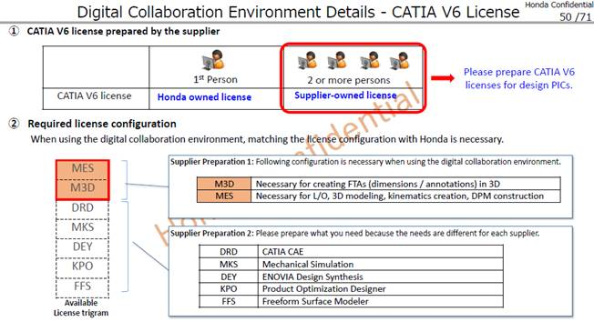
Confidential - DS Internal Information Sharing Purpose ONLY
Guest Engineer local usage license
 | For Guest Engineer* 1 license per supplier (Max2) |  | For Supplier
 | Local usage | Global usage | Local usage / Global usage
Eligible License configuration and Price(JPY) | Designer Package* PLC@3,500,000JPY※ ALC@630,000JPY(18%of PLC)※ | Designer Package* PLC@7,000,000JPY※ ALC@1,260,000JPY※ | MES+TAD Supplier will buy own license after April 1 2024
 | MES+TAD(Bundle) Coming soon | MES+TAD(Bundle) Coming soon
Eligible licensee | local Honda | HM Japan only | Supplier
Coming soon
New Purchase only
※Price should be converted by exchange rate in local DS side
*Guest Engineer=leader of supplier users and Honda subcontractor’s employee whose usual workplace is Honda premises working on dedicated Honda Machine, ID, VDI network
**HONDA Designer PKG（MES+TAD+MMO+DEY+TEO+VRR+SUM+SFO)

Slide 10
Confidential - DS Internal Information Sharing Purpose ONLY
Guest Engineer local usage detail condition
**Guest Engineer=leader of supplier users and Honda subcontractor’s employee whose usual workplace is Honda premises working on dedicated Honda Machine, ID, VDI network
New Purchase only (Outside of Japan)
Target License Designer Package* or MES+TAD PKG (Shareable)
Licensee: Eligible local Honda entities only
User: Licensee employee and guest engineer** belong to licensee
Eligible supplier: Listed supplier only, 1per each supplier max2
User location: supplier on premise within same country of licensee
Hosting client machine: MS Azure environment in same country of licensee
License server : To be separated as dedicated DSLS (including M-DSLS)
Price:
Remarks;
Price should be converted by local currency, through local SBO with pricer
Purchasing limit : Up to 25% of IB (MES, HD2) in local Honda
MES+TAD cannot be used separately.
Need to add usage scope and to be bundled
This condition is applied for Eligible Suppliers only. (Supplier list from HM)
* Designer Package (MES+TAD+MMO+DEY+TEO+VRR+SUM+SFO)
Designer PKG(shareable) | PLC@3,500,000JPY | ALC@ALC@630,000JPY(18%of PLC)
MES+TAD PKG(shareable) | PLC@ | ALC@
Coming soon

Slide 11
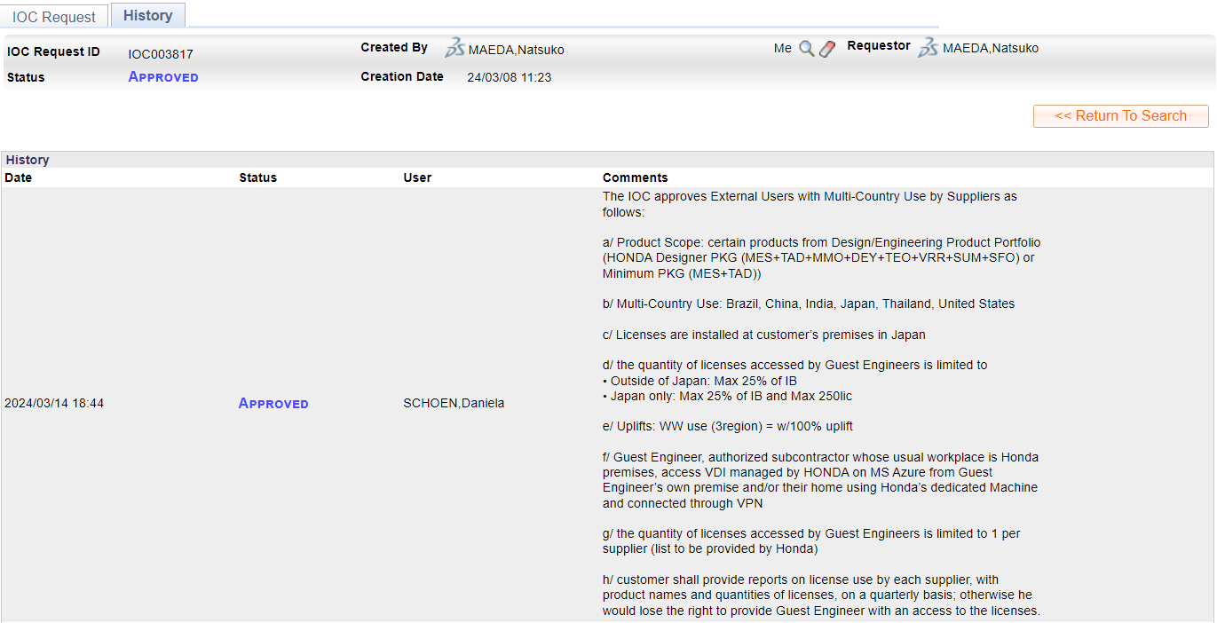
Ref: IOC approval (IOC003817)
Confidential - DS Internal Information Sharing Purpose ONLY

